Slide 1






Credit Risk Prediction & Default Analysis
SVM
Binary Classification
Good (0) or Default (1)
HUMAN REVIEW
Flags support informed decision making
APPLICANT
Objective: predict Good (0) or Default (1)
Decision support for human review
No automatic loan rejection

Slide 2






Dataset and Preparation
CLASS BALANCE
1,000 applicants • 23 columns
70%
30%
700 Good (70%) / 300 Default (30%)
700 Good
300 Default
Stratified split: 800 train / 200 held-out test
MISSING DATA (COUNT)
Remove observation_id and telephone; durations to months
telephone
596
checking balance
394
personal_status
310
Pipeline: impute → encode → scale
savings balance
183
residencehistory
130
All 310 missing personal_status entries belong to female records
employment_length
62
Missing values imputed and features encoded and scaled within model pipeline

Slide 3
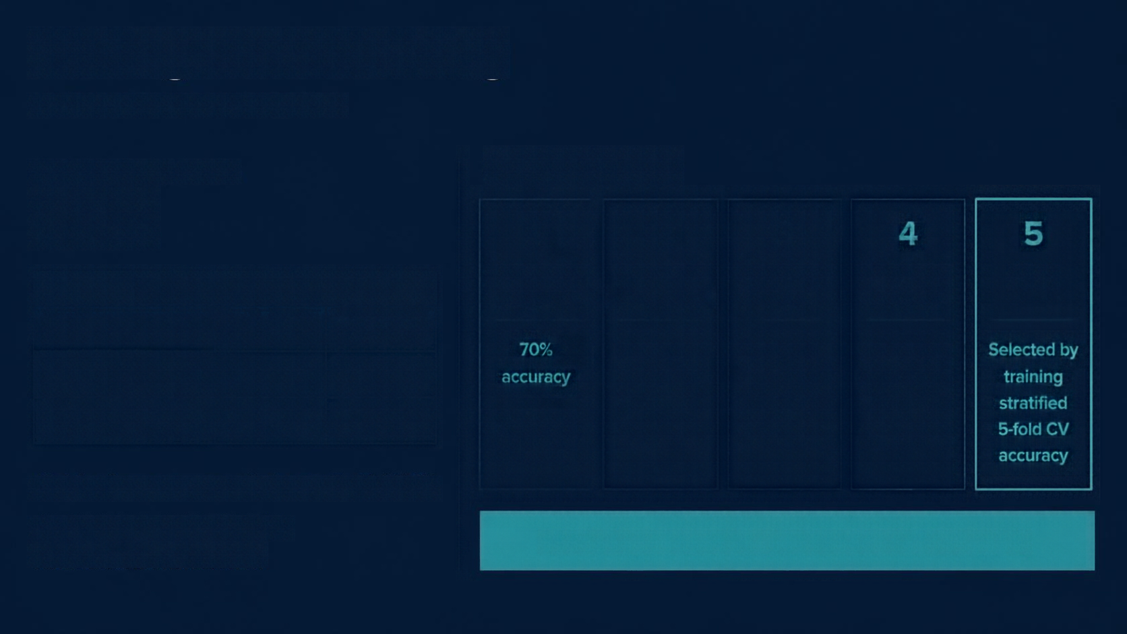








Findings and Modeling
TRAINING CROSS-VALIDATION
Training Default rate
MODELS EVALUATED
30%
1
2
3
4
5
MAJORITY
BASELINE
LOGISTIC
REGRESSION
DECISION
TREE
RANDOM
FOREST
SVM
MEDIAN COMPARISON
Good
Default
70%
accuracy
Linear model
interpretable
baseline performance
Captures non-linear patterns with simple rules
Ensemble of trees for more robust and stable results
Selected by training stratified 5-fold CV accuracy
Median loan amount
2,242.5
2,467.5
Median duration
18
24
Zero Default recall
Model performance compared using stratified 5-fold CV
Accuracy alone can be misleading
SVM selected by training stratified 5-fold CV accuracy
Associations are not causation

Slide 4





SVM
CONFUSION MATRIX (COUNTS)
HELD-OUT TEST
n200; positive Default(1)
PREDICTED
Good(0)
Default(1)
75.0%
Accuracy
56.0%
Default precision
Good(0)
103
37
78.3%
Recall
ACTUAL
Default F1 0.653
Default(1)
13
47
ROC-AUC 0.843
Average precision 0.745
Threshold chosen from training out-of-fold predictions; test kept out.
47
defaults detected
13
missed
Training OOF threshold requires >2/3 Default recall
37
Good flagged
SVM score is not a probability

Slide 5














Interpretation, Limitations and Conclusion
KEY TAKEAWAYS
EVALUATION CONTEXT
LIMITATIONS
CONCLUSION
Top features driving predictions
checking balance
months_loan duration
savings balance
credit history
property
Permutation importance reflects model reliance, not causation
Earlier diagnostic–not current
SVM evaluation
Female n61
recall75.0%, FPR43.3%
Male n139
recall80.0%, FPR27.3%
Descriptive only; not proof of fairness or unfairness
Small dataset with only1000 applicants and substantial missing data
Unequal subgroup sizes and female-linked missing personal_status constrain interpretation
No verified bank-specific cost analysis or real deployment results available
Model offers useful academic decision support
Further validation, fairness review, and business-cost calibration are required
Human review and ongoing monitoring are essential before operations
O&A
EARLIER DIAGNOSTIC SUBGROUP SUMMARY
NEXT STEPS
Subgroup
n
Recall
FPR
Business-cost thresholds with monitored
human review
Use more
representative
data
External
validation
Independent
fairness
review
Female
61
75.0%
43.9%
Male
139
80.0%
27.3%
Dataset only1000 with substantial missingsness. No bank-specific cost analysis, savings, or real deployment results available.
Human review and monitoring required before operations.

